Slide 1
Transport Layer
Process-to-Process Delivery:
UDP, TCP

Slide 2
our goals:
learn about Internet transport layer protocols:
  UDP: connectionless transport
  TCP: connection-oriented reliable transport
  TCP congestion control
Understand principles behind transport layer services:
  Process to Process delivery
  multiplexing, demultiplexing
  Error control
  congestion control

Slide 3

PROCESS-TO-PROCESS DELIVERY
The transport layer is responsible for realiable process-to-process delivery (the delivery of a packet, part of a message, from one process to another)
Figure Types of data deliveries

Slide 4
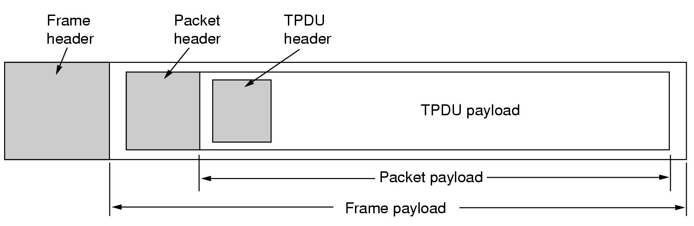
Nesting of TPDU, Packets, and Frames
Transport Protocol Data Unit (TPDU)
  Term used for transport entity to transport entity messages
TPDUs are contained in packets exchanged by network layer
Packets are contained in frames exchanged by data link layer

Slide 5
Processes:
Process is an instance of a program in execution.
Processes on two hosts communicate with each other by sending and receiving messages.
The process receives messages from, and sends messages into the network through its socket.

Slide 6
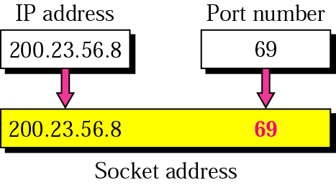
Socket address
Transport layer at the receiving host delivers data to the socket
There should be a unique identifier for each socket.
Socket identifier is called socket address
Socket address = IP address & Port number

Slide 7
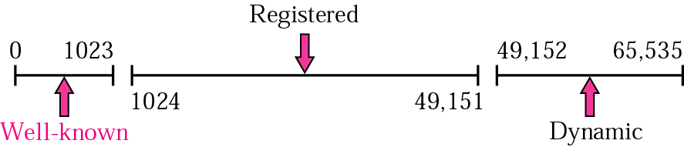
Figure 22.4 IANA ranges
Port numbers are 16-bit integers between 0 - 65535
The IANA divide the port numbers into three ranges
Well-known: Assigned and controlled by Internet Assigned Numbers Authority IANA for example: FTP 20,21, TELNET 23, SMTP 25, HTTP 80
Registered ports: The ports ranging from 1024 to 49,151 are not assigned or controlled by lANA.
Dynamic ports: The ports ranging from 49,152 to 65,535.

Slide 8

Figure 23.2 Port numbers

Slide 9
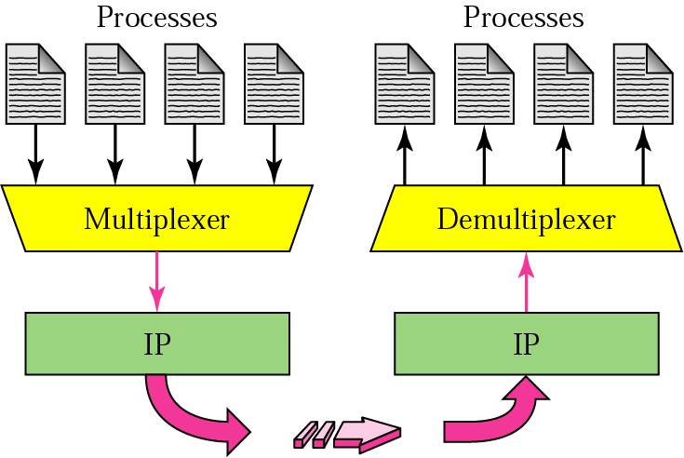
Figure 22.6 Multiplexing and demultiplexing
Sender
Receiver
Multiplexing: (at the sending node) The process of encapsulating data messages from different applications sockets with the header information and pass the segments to the network layer
DeMultiplexing: (at the receiving node) The process of delivering the received data segment to the correct application
Example: consider the example in next slide

Slide 10
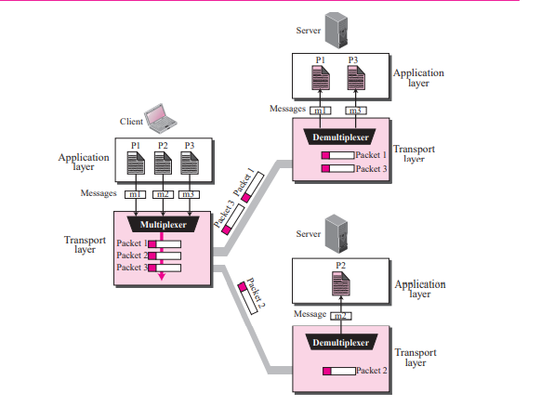
Figure 13.7 Multiplexing and demultiplexing
Suppose that the Three client processes are running at the client site, P1, P2, and P3
  The processes P1 and P3 need to send requests to the corresponding server process running in a server
  P2 needs to send a request to the corresponding server process running at another server
  It acts as a multiplexer
  When they arrive at the server, the transport layer does the job of a multiplexer

Slide 11
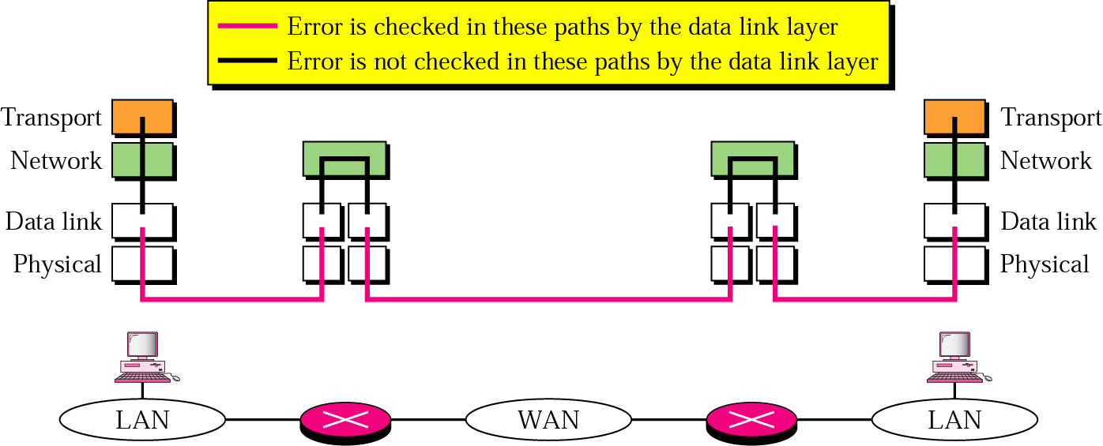
Figure 23.7 Error control
Why we need error control at the transport layer?

Slide 12
Transport Layer
Protocols
The Internet supports two transport layer protocols:
  The Transport Control Protocol (TCP) for reliable service
  The Unreliable (User) Datagram Protocol (UDP)

Slide 13
23-2 User Datagram Protocol (UDP)
Connectionless
  No handshaking between UDP sender, receiver
  Each UDP segment handled independently of others
A server application that uses UDP serves only ONE request at a time. All other requests are stored in a queue waiting for service.
Unreliable protocol has no flow and error control
  A UDP segment can be lost, arrive out of order, duplicated, or corrupted
  Checksum field checks error in the entire UDP segment. It is Optional
  UDP doe not do anything to recover from an error it simply discard the segment ➔ Application accepts full responsibility for errors
It uses port numbers to multiplex/demultiplex data from/to the application layer.
Advantages: Simple, minimum overhead, no connection delay
Services provided by UDP:
  Process-to-Process delivery
  Error checking (however, if there is an error UDP does NOT do anything to recover from error. It will just discard the message

Slide 14
UDP Applications
Used for applications that can tolerate small amount of packet loss:
  Multimedia applications,
  Internet telephony,
  real-time-video conferencing
  Domain Name System messages
  Audio
  Routing Protocols

Slide 15

Figure 23.9 User datagram format
Header size = 8 bytes
Minimum UDP process data size 0 bytes
Maximum UDP process data size=
65535 – 20 (network layer headers) - 8 (UDP headres)= 65507 bytes

Slide 16
23-3 Transmission Control Protocol (TCP)
Transmission Control Protocol properties:
  Connection-oriented (establishment & termination)
  Reliable
  Full-duplex

Slide 17
Connection-Oriented
Connection oriented means that a virtual connection is established before any data is transferred.
Connection ensures that the receiving process is available and ready before the data is sent
Three-way handshaking connection establishment procedure because TCP is full-duplex both side must initialize communication and get approval from the other side before any data transfer,
Virtual connection since TCP protocol will make sure that segments are given to the receiver application in the same order as they were sent by the sender even if they travel through different physical paths
A server application that uses TCP can handle many client requests at the same time each has its own connection.

Slide 18
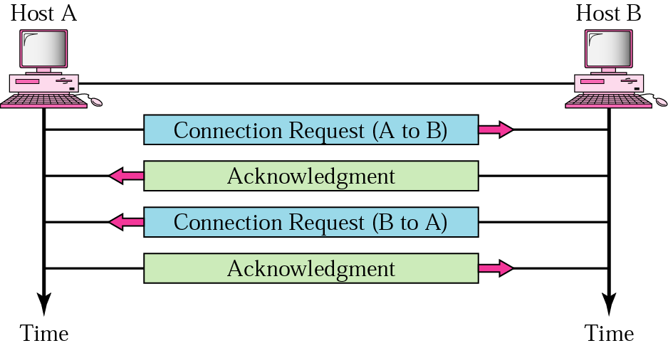
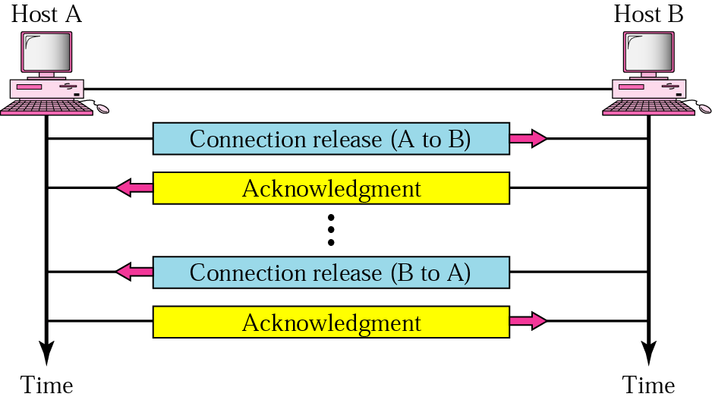
Connection establishment and termination
Connection establishment
Combined into one step
Connection release

Slide 19
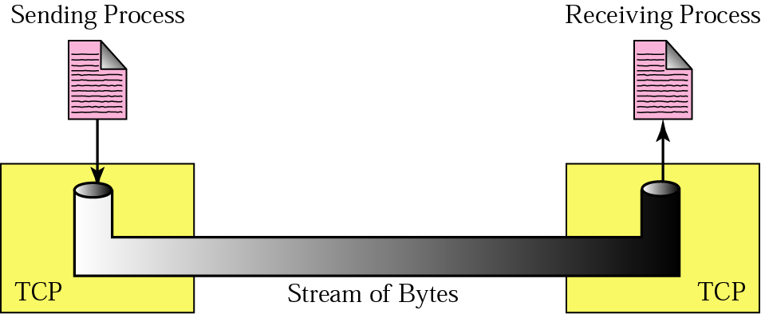
Figure 23.13 Stream delivery
TCP establishes a virtual connection
TCP will deliver segments to the applications in order and without error, lost, or duplicates

Slide 20
Full Duplex
Data segments can flow in both directions at the same time.
Each TCP connection has its own sending and receiving buffers.

Slide 21
Flow control and Reliability
Flow control (process-to-process): TCP makes sure that the sender does not cause the receiver buffer to overflow
  By defining the amount of data that can be sent before receiving an acknowledgement from the receiver (sliding – window protocols)
Error control (process-to-process): entire message arrives at the receiving transport layer without error, loss, duplication and in the same order they were sent
  Error detection is done using checksum and correction by retransmission
  Implemented by a sliding window ARQ
  Every transmission of data is acknowledged by the receiver.
  Acknowledgements are cumulative.
  If the sender does not receive ACK within a specified amount of time, the sender retransmits the data.
  Accepts out of order but does Not send negative acknowledgements,
  if a segment is not acknowledged before time-out, it is considered to be either corrupted or lost and the sender will retransmit the segment only when it times-out

Slide 22
TCP Applications
Following applications require reliable data transfer through TCP:
  WWW using HTTP
  Electronic mail using SMTP
  Telnet
  File transfer using FTP

Slide 23

Figure 23.16 TCP segment format
Minimum header length is 20 bytes and the maximum is 60 bytes when there are options

Slide 24
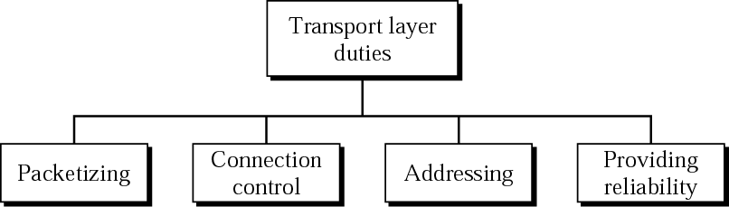
Transport layer duties
Packetizing
  Sender side: breaks application messages into segments, passes them to network layer
  Transport layer at the receiving host deliver data to the receiving process
Connection control
  Connection-oriented
  Connectionless
Addressing
  Port numbers to identify which network application
Reliability
  Flow control
  Error Control
  Congestion control
transport
-end transport

